Slide 1

Blockchain course BITCOIN PROTOCOL - A TECHNICAL OVERVIEW
Dr. Norbert Oláh

Slide 2

Table of Contents
Bitcoin Script

Slide 3
BITCOIN SCRIPT
Notes:
The ideologies that went behind the technology.

Slide 4


The UTXO MODEL
BITCOIN SCRIPT
Bitcoin uses a UTXO model
Transactions map inputs to outputs,
Transactions contain signature of owner of funds
Spending Bitcoin is redeeming previous transaction outputs
Locking Script = ScriptPubKey = Output
Unlocking Script = ScriptSig = Input
IN
Alice’s 5 BTC
Unlock with private key
OUT
Bob’s 1 BTC
Alice’s 4 BTC
IN
Send 1 BTC to Bob
Send 4 BTC back to self
OUT
Char’s
1 BTC
Send 1 BTC to Charlie
AUTHOR: MAX FANG & GLORIA ZHAO
EDITS: SISHIR
BLOCKCHAIN FUNDAMENTALS LECTURE 3
Notes:
Bitcoin uses a UTXO model to facilitate transactions. Transactions simply map inputs to outputs. These transactions also include signatures of the owners of funds.
In this model, spending Bitcoins is equivalent to redeeming previous transaction outputs.
Read, but then most importantly the last one. Spending bitcoin is redeeming
That is, we specify who can redeem some transaction. For example, if I send Brian some Bitcoin, then in that transaction it’s encoded that only Brian will be able to redeem it.
So I need more information than just inputs and outputs, to make sure we have valid transactions

Slide 5
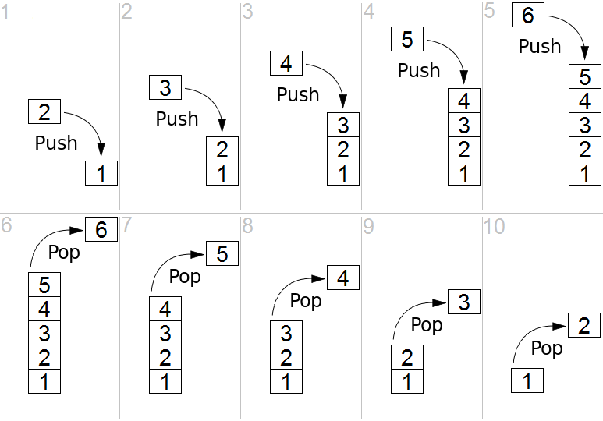
SCRIPT PROGRAMMING LANGUAGE
BITCOIN SCRIPT
Properties:
No loops (Not Turing complete)
Stack based
Several operators
EXAMPLES:
P2pkh: OP_DUP OP_HASH160 <PKHash> OP_EQUALVERIFY OP_CHECKSIG
Simpler example: OP_3 OP_4 OP_EQUAL OP_IF OP_5 OP_ELSE OP_10 OP_ENDIF

Slide 6
BITCOIN SCRIPTS
MORE SCRIPT OPERATORS
OP_TRUE
OP_FALSE
OP_NOT
OP_NOP
OP_RETURN <20 bytes in hex>
OP_ADD OP_SUB OP_2 OP_EQUAL
OP_HASH256 <32 bytes in hex> OP_EQUAL
2 <pubkey A> <pubkey B> <pubkey C> 3 OP_CHECKMULTISIG

Slide 7
SCRIPTS IN ACTION
TRANSACTION SCRIPTS
P2PK (Pay to pub Key)
Satoshi picked, First script type sending directly to connected nodes.
P2PKH (Pay to PubKey Hash)
First “address type” tx script. Starts with “1”
Introduced the idea of hash in scriptPubKey to hide full pubKey & UTXO
P2SH (Pay to Script Hash)
Starts with “3”.
Receiver in charge of sendinc policy & should pay for increased fee size
P2WPKH (Pay to Witness PubKey Hash)
P2WSH (Pay to Witness Script Hash)

Slide 8
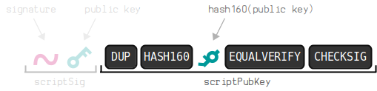
P2PKH IN ACTION
TRANSACTION SCRIPTS
SCRIPT: <Signature> <PublicKey> OP_DUP OP_HASH160 <PKHash> OP_EQUALVERIFY OP_CHECKSIG
STACK
<Signature>

Slide 9
P2PKH IN ACTION
TRANSACTION SCRIPTS
SCRIPT: <Signature> <PublicKey> OP_DUP OP_HASH160 <PKHash> OP_EQUALVERIFY OP_CHECKSIG
<PublicKey>
STACK
<Signature>

Slide 10
P2PKH IN ACTION
TRANSACTION SCRIPTS
SCRIPT: <Signature> <PublicKey> OP_DUP OP_HASH160 <PKHash> OP_EQUALVERIFY OP_CHECKSIG
<OP_DUP>
<PublicKey>
STACK
<Signature>

Slide 11
P2PKH IN ACTION
TRANSACTION SCRIPTS
SCRIPT: <Signature> <PublicKey> OP_DUP OP_HASH160 <PKHash> OP_EQUALVERIFY OP_CHECKSIG
<OP_HASH160>
<PublicKey>
<PublicKey>
STACK
<Signature>

Slide 12
P2PKH IN ACTION
TRANSACTION SCRIPTS
SCRIPT: <Signature> <PublicKey> OP_DUP OP_HASH160 <PKHash> OP_EQUALVERIFY OP_CHECKSIG
RIPEMD( SHA256( top item ) )
<OP_HASH160>
<PublicKey>
<PublicKey>
STACK
<Signature>

Slide 13
P2PKH IN ACTION
TRANSACTION SCRIPTS
SCRIPT: <Signature> <PublicKey> OP_DUP OP_HASH160 <PKHash> OP_EQUALVERIFY OP_CHECKSIG
RIPEMD( SHA256( top item ) )
<PKHASH>
<PKHASH>
<PublicKey>
STACK
<Signature>

Slide 14
P2PKH IN ACTION
TRANSACTION SCRIPTS
SCRIPT: <Signature> <PublicKey> OP_DUP OP_HASH160 <PKHash> OP_EQUALVERIFY OP_CHECKSIG
<OP_EQUALVERIFY>
RIPEMD( SHA256( top item ) )
<PKHASH>
<PKHASH>
<PublicKey>
STACK
<Signature>

Slide 15
P2PKH IN ACTION
TRANSACTION SCRIPTS
SCRIPT: <Signature> <PublicKey> OP_DUP OP_HASH160 <PKHash> OP_EQUALVERIFY OP_CHECKSIG
<OP_CHECKSIG>
<PublicKey>
STACK
<Signature>

Slide 16
P2PKH IN ACTION
TRANSACTION SCRIPTS
SCRIPT: <Signature> <PublicKey> OP_DUP OP_HASH160 <PKHash> OP_EQUALVERIFY OP_CHECKSIG
STACK
TRUE

Slide 17
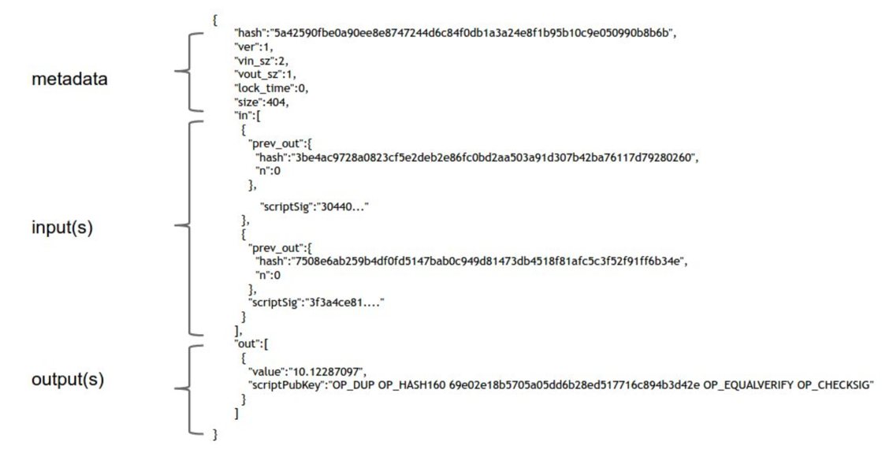
CONTENTS OF A TRANSACTION
Source: Princeton Textbook
Notes:
This is very close to the actual representation of a Bitcoin transaction, it's not just not byte-encoded (it hasn’t been turned into 1s and 0s so that a machine can read it)
ScriptSig is input, hash is reference to previous output
- There's some metadata, inputs, and outputs
- In the metadata, there's some housekeeping data (ver, vin_sz, vout_sz), hash (serves as unique ID of the transaction), and locktime, which is useful for bitcoin scripting.
- In the inputs, we have the transaction id (which is the hash of the referenced transaction), and the index of the output in the previous transaction. We also have scriptSig, which is the signature used to redeem the previous transaction output.
- In the outputs, we have a value, and a Bitcoin script.

Slide 18
CONTENTS OF AA TRANSACTION - METADATA
{
“hash”: “5a42590fbe0a90ee8e8747244d6c84f0db1a3a24e8f1b95b10c9e050990b8b6b”,
“ver”: 1, “vin_sz”: 2, “vout_sz”: 1,
“lock_time”: 0,
“size”: 404,
hash or “ID”
of this transaction
“in”: [
{
“prev_out”: {
“hash”: “3be4ac9728a0823cf5e2deb2e86fc0bd2aa503a91d307b42ba76117d79280260”,
“n”: 0 },
“scriptSig”: “30440…” },
{
“prev_out”: {
“hash”: “7508e6ab259b4df0fd5147bab0c949d81473db4518f8afc5c3f52f91ff6b34e”,
“n”: 0
},
“scriptSig”: “3f3a4ce81….”
}
],
“out”: [
{
“value”: 10.12287097”,
“scriptPubKey”: “OP_DUP OP_HASH160 69e02e18b5705a05dd6b28ed517716c894b3d42e OP_EQUALVERIFY OP_CHECKSIG”
}
]
}
Source: Princeton Textbook
Notes:
So let's take an even closer look at what transactions are. This is very close to the actual representation of a Bitcoin transaction, it's not just not byte-encoded.
- There's some metadata, inputs, and outputs
- In the metadata, there's some housekeeping data (ver, vin_sz, vout_sz), hash (serves as unique ID of the transaction), and locktime, which is useful for bitcoin scripting. We'll talk more about locktime in our scalability lecture
- In the inputs, we have the transaction id (which is the hash of the referenced transaction), and the index of the output in the previous transaction. We also have scriptSig, which is the signature used to redeem the previous transaction output.
- In the outputs, we have a value, and a Bitcoin script.

Slide 19
CONTENTS OF A TRANSACTION - METADATA
{
“hash”: “5a42590fbe0a90ee8e8747244d6c84f0db1a3a24e8f1b95b10c9e050990b8b6b”,
“ver”: 1, “vin_sz”: 2, “vout_sz”: 1,
“lock_time”: 0,
“size”: 404,
size (number) of inputs
hash or “ID”
of this transaction
size (number) of outputs
“in”: [
{
“prev_out”: {
“hash”: “3be4ac9728a0823cf5e2deb2e86fc0bd2aa503a91d307b42ba76117d79280260”,
“n”: 0 },
“scriptSig”: “30440…” },
{
“prev_out”: {
“hash”: “7508e6ab259b4df0fd5147bab0c949d81473db4518f8afc5c3f52f91ff6b34e”,
“n”: 0
},
“scriptSig”: “3f3a4ce81….”
}
],
“out”: [
{
“value”: 10.12287097”,
“scriptPubKey”: “OP_DUP OP_HASH160 69e02e18b5705a05dd6b28ed517716c894b3d42e OP_EQUALVERIFY OP_CHECKSIG”
}
]
}
Source: Princeton Textbook
Notes:
So let's take an even closer look at what transactions are. This is very close to the actual representation of a Bitcoin transaction, it's not just not byte-encoded.
- There's some metadata, inputs, and outputs
- In the metadata, there's some housekeeping data (ver, vin_sz, vout_sz), hash (serves as unique ID of the transaction), and locktime, which is useful for bitcoin scripting. We'll talk more about locktime in our scalability lecture
- In the inputs, we have the transaction id (which is the hash of the referenced transaction), and the index of the output in the previous transaction. We also have scriptSig, which is the signature used to redeem the previous transaction output.
- In the outputs, we have a value, and a Bitcoin script.

Slide 20
CONTENTS OF A TRANSACTION - METADATA
{
“hash”: “5a42590fbe0a90ee8e8747244d6c84f0db1a3a24e8f1b95b10c9e050990b8b6b”,
“ver”: 1, “vin_sz”: 2, “vout_sz”: 1,
“lock_time”: 0,
“size”: 404,
version
size (number) of inputs
hash or “ID”
of this transaction
size (number) of outputs
lock time (useful for scripting)
size of transaction
“in”: [
{
“prev_out”: {
“hash”: “3be4ac9728a0823cf5e2deb2e86fc0bd2aa503a91d307b42ba76117d79280260”,
“n”: 0 },
“scriptSig”: “30440…” },
{
“prev_out”: {
“hash”: “7508e6ab259b4df0fd5147bab0c949d81473db4518f8afc5c3f52f91ff6b34e”,
“n”: 0
},
“scriptSig”: “3f3a4ce81….”
}
],
“out”: [
{
“value”: 10.12287097”,
“scriptPubKey”: “OP_DUP OP_HASH160 69e02e18b5705a05dd6b28ed517716c894b3d42e OP_EQUALVERIFY OP_CHECKSIG”
}
]
}
Source: Princeton Textbook
Notes:
We’re going to be primarily focused on the inputs and outputs of this transaction, but here is what the other variables mean if you’re curious.

Slide 21
CONTENTS OF A TRANSACTION - INPUTS
“hash”: “5a42590fbe0a90ee8e8747244d6c84f0db1a3a24e8f1b95b10c9e050990b8b6b”,
“ver”: 1, “vin_sz”: 2, “vout_sz”: 1,
remember these?
“in”: [
{
“prev_out”: {
“hash”: “3be4ac9728a0823cf5e2deb2e86fc0bd2aa503a91d307b42ba76117d79280260”,
“n”: 0 },
“scriptSig”: “30440…” },
{
“prev_out”: {
“hash”: “7508e6ab259b4df0fd5147bab0c949d81473db4518f8afc5c3f52f91ff6b34e”,
“n”: 0
},
“scriptSig”: “3f3a4ce81….”
}
],
Source: Princeton Textbook
Notes:
So let's take an even closer look at what transactions are. This is very close to the actual representation of a Bitcoin transaction, it's not just not byte-encoded.
- There's some metadata, inputs, and outputs
- In the metadata, there's some housekeeping data (ver, vin_sz, vout_sz), hash (serves as unique ID of the transaction), and locktime, which is useful for bitcoin scripting. We'll talk more about locktime in our scalability lecture
- In the inputs, we have the transaction id (which is the hash of the referenced transaction), and the index of the output in the previous transaction. We also have scriptSig, which is the signature used to redeem the previous transaction output.
- In the outputs, we have a value, and a Bitcoin script.

Slide 22
CONTENTS OF A TRANSACTION - INPUTS
“hash”: “5a42590fbe0a90ee8e8747244d6c84f0db1a3a24e8f1b95b10c9e050990b8b6b”,
“ver”: 1, “vin_sz”: 2, “vout_sz”: 1,
remember these?
“in”: [
{
“prev_out”: {
“hash”: “3be4ac9728a0823cf5e2deb2e86fc0bd2aa503a91d307b42ba76117d79280260”,
“n”: 0 },
“scriptSig”: “30440…” },
{
“prev_out”: {
“hash”: “7508e6ab259b4df0fd5147bab0c949d81473db4518f8afc5c3f52f91ff6b34e”,
“n”: 0
},
“scriptSig”: “3f3a4ce81….”
}
],
input 1:
ID of previous transactions being referenced
input 2:
Source: Princeton Textbook
Notes:
In this particular transaction represented by this piece of code, this transaction has two inputs. Aka, it’s breaking two piggy banks with these two IDs.

Slide 23
CONTENTS OF A TRANSACTION - INPUTS
“hash”: “5a42590fbe0a90ee8e8747244d6c84f0db1a3a24e8f1b95b10c9e050990b8b6b”,
“ver”: 1, “vin_sz”: 2, “vout_sz”: 1,
remember these?
“in”: [
{
“prev_out”: {
“hash”: “3be4ac9728a0823cf5e2deb2e86fc0bd2aa503a91d307b42ba76117d79280260”,
“n”: 0 },
“scriptSig”: “30440…” },
{
“prev_out”: {
“hash”: “7508e6ab259b4df0fd5147bab0c949d81473db4518f8afc5c3f52f91ff6b34e”,
“n”: 0
},
“scriptSig”: “3f3a4ce81….”
}
],
input 1:
index of input in previous transaction
ID of previous transactions being referenced
input 2:
index of input in previous transaction
Source: Princeton Textbook
Notes:
So let's take an even closer look at what transactions are. This is very close to the actual representation of a Bitcoin transaction, it's not just not byte-encoded.
- There's some metadata, inputs, and outputs
- In the metadata, there's some housekeeping data (ver, vin_sz, vout_sz), hash (serves as unique ID of the transaction), and locktime, which is useful for bitcoin scripting. We'll talk more about locktime in our scalability lecture
- In the inputs, we have the transaction id (which is the hash of the referenced transaction), and the index of the output in the previous transaction. We also have scriptSig, which is the signature used to redeem the previous transaction output.
- In the outputs, we have a value, and a Bitcoin script.

Slide 24
CONTENTS OF A TRANSACTION - INPUTS
remember these?
“in”: [
{
“prev_out”: {
“hash”: “3be4ac9728a0823cf5e2deb2e86fc0bd2aa503a91d307b42ba76117d79280260”,
“n”: 0 },
“scriptSig”: “30440…” },
{
“prev_out”: {
“hash”: “7508e6ab259b4df0fd5147bab0c949d81473db4518f8afc5c3f52f91ff6b34e”,
“n”: 0
},
“scriptSig”: “3f3a4ce81….”
}
],
input 1:
signature used to redeem previous transaction output
input 2:
signature used to redeem previous transaction output
Source: Princeton Textbook
Notes:
So let's take an even closer look at what transactions are. This is very close to the actual representation of a Bitcoin transaction, it's not just not byte-encoded.
- There's some metadata, inputs, and outputs
- In the metadata, there's some housekeeping data (ver, vin_sz, vout_sz), hash (serves as unique ID of the transaction), and locktime, which is useful for bitcoin scripting. We'll talk more about locktime in our scalability lecture
- In the inputs, we have the transaction id (which is the hash of the referenced transaction), and the index of the output in the previous transaction. We also have scriptSig, which is the signature used to redeem the previous transaction output.
- In the outputs, we have a value, and a Bitcoin script.

Slide 25
CONTENTS OF A TRANSACTION - OUTPUTS
{
“hash”: “5a42590fbe0a90ee8e8747244d6c84f0db1a3a24e8f1b95b10c9e050990b8b6b”,
“ver”: 1, “vin_sz”: 2, “vout_sz”: 1,
“lock_time”: 0,
“size”: 404,
“in”: [
{
“prev_out”: {
“hash”: “3be4ac9728a0823cf5e2deb2e86fc0bd2aa503a91d307b42ba76117d79280260”,
“n”: 0 },
“scriptSig”: “30440…” },
{
“prev_out”: {
“hash”: “7508e6ab259b4df0fd5147bab0c949d81473db4518f8afc5c3f52f91ff6b34e”,
“n”: 0
},
“scriptSig”: “3f3a4ce81….”
}
],
output amount (how much BTC is being sent)
“out”: [
{
“value”: 10.12287097”,
“scriptPubKey”: “OP_DUP OP_HASH160 69e02e18b5705a05dd6b28ed517716c894b3d42e OP_EQUALVERIFY OP_CHECKSIG”
}
]
}
type of script
output script
Source: Princeton Textbook
Notes:
So let's take an even closer look at what transactions are. This is very close to the actual representation of a Bitcoin transaction, it's not just not byte-encoded.
- There's some metadata, inputs, and outputs
- In the metadata, there's some housekeeping data (ver, vin_sz, vout_sz), hash (serves as unique ID of the transaction), and locktime, which is useful for bitcoin scripting. We'll talk more about locktime in our scalability lecture
- In the inputs, we have the transaction id (which is the hash of the referenced transaction), and the index of the output in the previous transaction. We also have scriptSig, which is the signature used to redeem the previous transaction output.
- In the outputs, we have a value, and a Bitcoin script.

Slide 26
SOME NOTES
BITCOIN SCRIPT
Output “addresses” are actually scripts.
This particular Output Script: “This amount can be redeemed by the public key that hashes to address X, plus a signature from the owner of that public key”
Inputs and outputs through scripting allows for future extensibility of Bitcoin.
Script or “Bitcoin Scripting Language”: Language built specifically for Bitcoin
Stack based
Simple, not turing complete (no loops)
“scriptPubKey”: “OP_DUP OP_HASH160 69e02e18b5705a05dd6b28ed517716c894b3d42e OP_EQUALVERIFY OP_CHECKSIG”
Source: Princeton textbook
Notes:
So it should be clear by now that the outputs are pretty important. More specifically, it’s really important you make sure a transaction can only be redeemed by the person you want to be able to.
Each output doesn't simply specify an address, it specifies a script. Inputs are scripts also!
- Why use Bitcoin scripts instead of simply assigning public keys? It allows for more functionality and extensibility of Bitcoin.
Here are the semantics of an output.
(go through points)
So, let's walk through an example

Slide 27
Questions?

Slide 28
Thank you for your attention!

